Slide 2
Found Poems
A type of poetry created by taking words, phrases, and sometimes whole passages from other sources and reframing them as poetry by making changes in spacing and lines, or by altering the text by additions and deletions.
Students use the authors words to create their own new text.

Slide 3
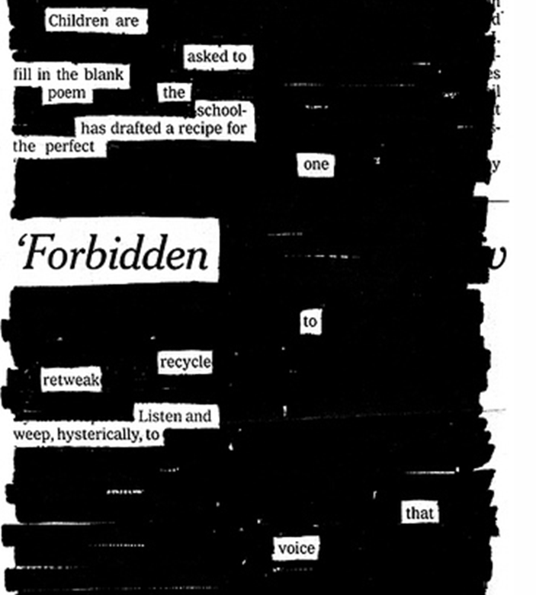
News Paper Blackout Poems
By: Austin Kleon

Slide 4
Found Poem
by Jada Johnson
Using a passage from
Nancy Ruppert’s ‘Differentiation for the 21st Century’

Slide 5
Found Poems in the Classroom
Poems need to retain the meaning of the original text.
Students must carefully consider the author’s purpose, syntax, and specific word choices.
This encourages students to discover how authors use specific words and images to capture the essence of their writing and the information they would like to convey.

Slide 6
Found Poems in the Classroom
Supports comprehension after reading
Used as a review of vocabulary and key terms
Gives literary experience in classes outside of language arts
Encourages the use of figurative and descriptive language
Students become more insightful readers and develop creativity in thinking and writing

Slide 7
Creating a Found Poem
As they read through the passage circle, highlight, or list the strongest words in the passage. Strike through repetitive or unnecessary words.
Pay special attention to the author’s original meaning, word choice, word order, and phrases that require emphasis or reflect back to information presented in the content lesson.
Emphasize purposeful reading first, otherwise students will focus on the technical aspects of creating a poem instead.

Slide 8
Creating a Found Poem
Start poems with a strong word or phrase.
As much as possible, honor the author’s original word order. Think about which phrases require emphasis.
Edit the poem for verb tense and add words to maintain grammatical sense (keep additions to a minimum).
Title the work and write a final draft to present or turn in. Include a citation of the text used.

Slide 9
References
Fisher, D., Brozo, W. G., Frey, N., & Ivey, G. (2011). 50 instructional routines to develop content literacy. (2 ed., pp. 31-33). Boston: Pearson.
Jenkins, M. (2000). Teach yourself 101 key ideas: Genetics. (1 ed., pp. 1-101). Chicago: NTC/Contemporary Publishing.

Slide 10
Directions (Printed Out)
As you read through your passage circle or list the strongest words in the passage. Strike through any repetitive or unnecessary words.
Pay special attention to: words and vocabulary that we have covered in class, causes, & symptoms/ problems associated with condition.
Start your poem with a strong word or phrase. As much as possible honor the author’s original word order. Think about which phrases require emphasis.
Edit your poem for verb tense and add words to maintain grammatical sense (keep additions to a minimum).
Title your work and write a final draft to present to the class.

