Slide 1
Journals & Daily Oral Language
Mrs. Russell

Slide 2
TGG Reading Calendar
Ch Pages Date Completed by
1-21 10/12
23-38 10/15
39-59 10/17
61-80 10/22
81-96 10/23
97-111 10/25
113-145 10/29
147-163 11/1 – Thursday
163-180 11/5 – Monday (2 wks)
Items in red have been checked as of Wednesday, 10/24 and were on last 9 weeks.

Slide 3
DOL – Monday, 10/15
Today I saw a man riding a motorcycle with a broken leg.

Slide 4
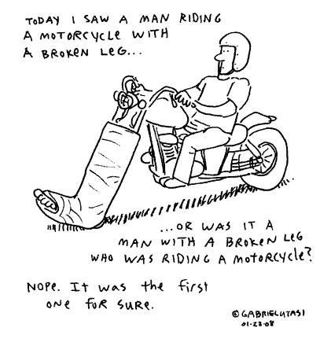

Slide 5
Journal - Monday, 10/5
In “The Great Gatsby” Daisy wants her daughter to grow up to be a fool in hopes that she will be protected from heartache. What’s the ONE (1) most important lesson that you have learned from your parents/guardians?
10 lines, margin to margin in your journal. Don’t forget to date and title.

Slide 6
DOL – Tuesday, 10/16
Using a semicolon isn’t hard I saw a party gorilla do it.

Slide 7
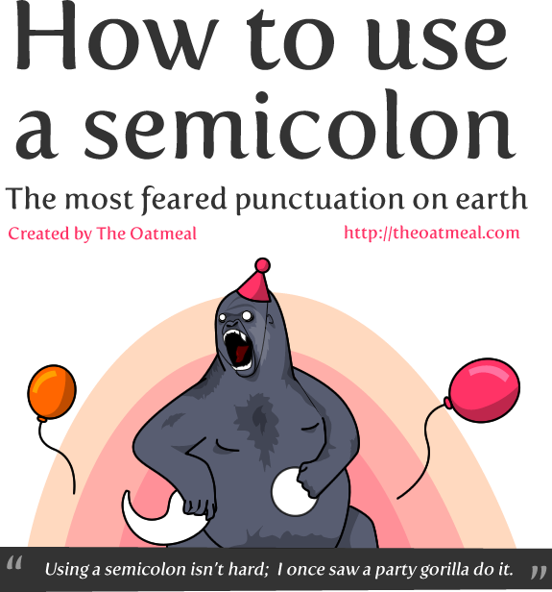

Slide 8
DOL - Semicolons
http://theoatmeal.com/comics/semicolon

Slide 9
Red Ribbon Week – Monday
KICK DRUGS TO THE CURB! Wear boots!
There is a heated debate in the country right now over the fact that medicinal marijuana should be legalized or not. If MM is legalized, it will be available for prescription to terminal (dying) or chronic patients. Also, if the government controls the drugs, then the government gets the money.
WHAT’S YOUR TAKE ON LEGALIZING MARIJUANA FOR CHRONIC/TERMINAL PATIENTS?

Slide 10
LEGALIZE
17 of 50 states said yes
Proponents says it’s effective in pain management – but can only cite peer-reviewed studies
Peer-reviewed studies show that MM helps relieve stress in dying patients
The air quality in bigger cities is just as bad as inhaling 2nd hand M smoke
Sick patients gained rather than lost weight.
Patients will use less than prescription pills and therefore have less medicine in their system.
DON’T LEGALIZE
CSA has studies to prove there is “no acceptable medical use”
FDA says it’s dangerous, addictive, and injures the lungs, immune system, and brain.
Gateway drug to illegal drugs
There are plenty of approved drugs for pain management
M damages bronchial passages that cannot be repaired which leads to chronic bronchitis and pneumonia.
Sleep difficulty, depression, irritability, and restlessness.

Slide 11
DOL
Instructions: Write the correct comparative and superlative forms for the following adjectives. You can form the comparative with er and the superlative with est UNLESS IT’S IRREGULAR!
1. glad
2. small
3. funny
4. good
5. bad

Slide 12
DOL
Instructions: Write the correct comparative and superlative forms for the following adjectives.
1. glad, gladder, gladdest
2. small, smaller, smallest
3. funny, funnier, funniest
4. good, better, best
5. bad, worse, the worst

Slide 13
I like to run, to eat, and to play in the park.
I like running, eating, and to play in the park. NOT
I played with my sister at the park. We went to slide and swing. I like the park.

Slide 14
If you start in the past, stay in the past. If you start in the present, stay in the present.

Slide 15
Journal – 10/22
There are two different set of rules for everyone: society’s rules and individual’s rules. For many people, these rules are separate lists. Why do you think these lists are different? Are your two lists different and why/why not?
10 lines, margin to margin in your journal. Don’t forget to date and title.

Slide 16
DOL – 10/22
http://www.chompchomp.com/irregular01/irregular01.htm

Slide 17
Journal – Friday, 10/26
Now that you’ve thrown a Gatsby party, tell me what your next birthday party will look like. Are you low key and just like a family dinner and cake with your 2 best friends or do you invite waaaaaaay too many people and have food, music, a huge cake, and all the bells and whistles?

Slide 18
DOL
SPELLING & 4 MUST HAVE HELPERS
I before E, except after C
Drop the final E
Final Y to I
Double the final consonant

Slide 19
I before E
Use i before e, except after c, or when sounded as "a" as in "neighbor" and "weigh." EXAMPLES: believe, chief, piece, and thief; deceive, receive, weigh, and freight COMMON EXCEPTIONS: efficient, weird, height, neither, ancient, caffeine, foreign

Slide 20
Dropping the Final E
Drop the final e before a suffix beginning with a vowel (a, e, i, o, u) but not before a suffix beginning with a consonant. EXAMPLES: ride + ing = riding guide + ance = guidance hope + ing = hoping entire + ly = entirely like + ness = likeness arrange + ment = arrangement COMMON EXCEPTIONS: truly, noticeable

Slide 21
Changing a Final Y to I
Change a final y to i before a suffix, unless the suffix begins with i. EXAMPLES: defy + ance = defiance party + es = parties pity + ful = pitiful try + es = tries try + ing = trying copy + ing = copying occupy + ing = occupying COMMON EXCEPTIONS: journeying, memorize

Slide 22
Doubling a Final Consonant
Double a final single consonant before a suffix beginning with a vowel when both of these conditions exist: (a) a single vowel precedes the consonant; (b) the consonant ends an accented syllable or a one-syllable word. EXAMPLES: stop + ing = stopping admit + ed = admitted occur + ence = occurrence stoop + ing = stooping benefit + ed = benefited delight + ful = delightful

Slide 23
Monday, 10/29
FROM MEMORY, ANSWER…
What are the 8 parts of speech?
Define constitute
Journal - What constitutes a good weekend?
DOL – What is passive voice?

Slide 24
8 parts of speech
Noun
Verb
Adjective
Adverb
Pronoun
Preposition
Conjunction
Interjection

Slide 25
Monday, 10/29
Noun, verb, adjective, adverb, pronoun, preposition, conjunction, & interjection
Constitute – to be part of a whole
Journal – Discuss
Passive voice is used when the focus is on the action. It is not important or not known, however, who or what is performing the action. Example: My bike was stolen.
In the example above, the focus is on the fact that my bike was stolen. I do not know, however, who did it.
Sometimes a statement in passive is more polite than active voice, as the following example shows: Example: A mistake was made.
In this case, I focus on the fact that a mistake was made, but I do not blame anyone (e.g. You have made a mistake.).

Slide 26
Tuesday, October 30
Write 1 sentence in active voice.
Underline the verb and draw an arrow to “who” is doing the action.
Write 1 sentence in passive voice.
Underline the verb.
Journal – What regrets do you have?

Slide 27
Tuesday, October 30
Write 1 sentence in active voice.
Katie ate my lunch.
Write 1 sentence in passive voice.
My lunch was eaten.
Journal – What regrets do you have?
Grades as an underclassman/woman, dates, friendships, fights with parents, forgiveness, and etc.

